Slide 1
Been there, done that:
Anecdotes and lessons learned from 40 years with CS and AI
Kary Främling
Professor in Data Science
Head of Explainable AI Team
The work is partially supported by the Wallenberg AI, Autonomous Systems and Software Program (WASP) funded by the Knut and Alice Wallenberg Foundation.

Slide 2
Kary Främling in a nutshell
Professor,
Umeå Universitet, 2017-
Born in Borgå (Porvoo),
Finland 1965
M.Sc. in CS, Helsinki University
of Technology, 1990
Computers in Industry
Artificial Intelligence (AI)
Mechatronics
Research Director,
Louhe Oy 2020-
PhD, Saint-Etienne, France 1996
Decision Support Systems
Neural Networks
Explainable AI
Adjunct Professor in
Computer Science,
Aalto university
2018-
Professor of Practice in Building Information Modeling, Aalto University, Finland 2013-2018

Slide 3
The World in the 1980’s
”AI will take all jobs” already in the 1980’s
Big things in the 1980’s:
  Rule-based systems (also called ”expert systems”)
  Semantic nets
  Certainty factors, probabilities for managing uncertainty
  Machine learning:
    Induction, deduction, abduction learning
    Case-based reasoning
    Decision trees
    Bayesian reasoning
Neural Nets had been “killed” in 1969
The era of GOFAI (Good Old-Fashioned AI)

Slide 4
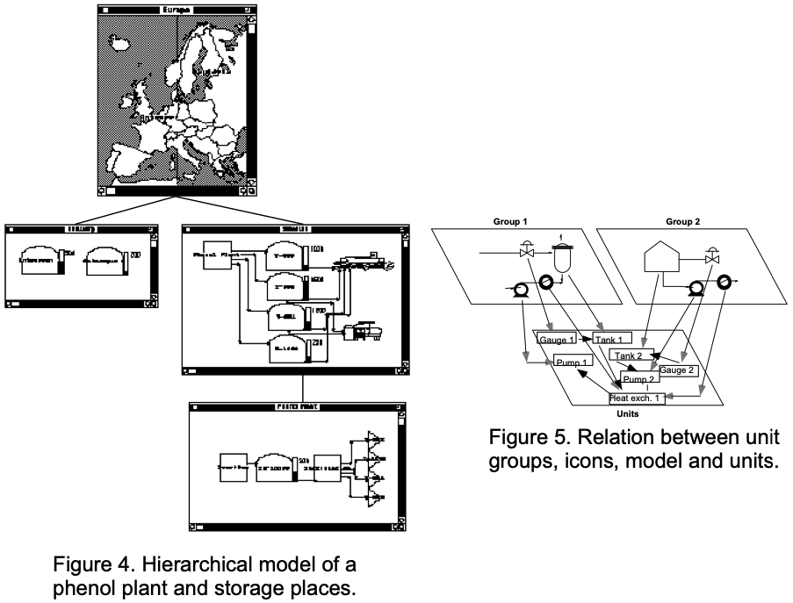
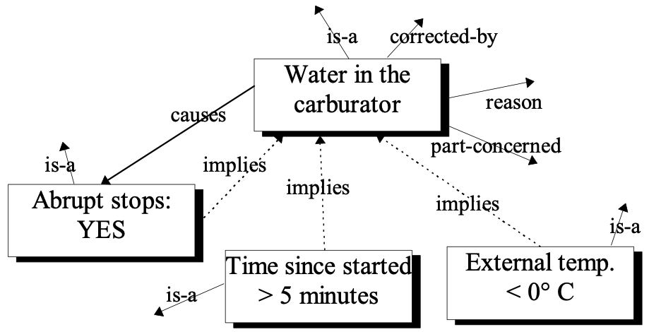
What did Kary do in (end of) 1980’s?
M.Sc. thesis in 1990: “Digital Twin” of phenol plant
  Used Smalltalk, Prolog programming languages
  Production scheduling using plant model, rule-based AI and “real-life” information
Kary still says “the evolution of programming languages could have finished with Smalltalk” (because Java, Python etc. mainly imitate it)
Weighted Semantic Nets for heuristic search, fault diagnosis etc.
  Semantic nets are now gaining in popularity again, under the name
  Knowledge Graphs
  An almost identical example used in a recent (2024) paper as
  in Kary’s M.Sc. Thesis, below (which was inspired from elsewhere)
  Certainty factors could be propagated and indicated for the result

Slide 5
Nokia Cellular Systems and TN-SDL
Kary implemented a (very small) part of the GSM system for Nokia Cellular Systems 1990-1991
Core tool TN-SDL (TeleNokia Specification and Description Language (SDL)):
  Formal, graphical language for defining event-driven systems, such as communication protocols
  Used especially in the telecommunications industry for designing complex, reactive and concurrent distributed systems like switching systems and mobile networks
  Graphical Representation: Uses a block-diagram approach to represent processes, signals, and communication paths
  Often used in combination with UML (Unified Modeling Language) and other tools for the formal verification and validation of system designs
GSM specification was modeled in TN-SDL tool, which generated most of the needed code in C, as well as test scripts and documentation
  Verification and validation tests were first run locally and/or sent to a dedicated server
  When everything had passed, a final test was run on a mobile mini-switch with the actual hardware
Generating code, test scripts and documentation is efficient and correct when it’s based on formal specifications!

Slide 6
The World in the 1990’s
GOFAI winter starts, including “symbolic machine learning” methods to a large extent
Neural Networks is the big thing, and there are many types:
  Hopfield, Boltzmann, Radial Basis Function (RFB), self-organizing map, Neural Gas, ART (Adaptive Resonance Theory network), …
  Obviously: Multi-layer, gradient descent network
    Strange “accepted truth”: you never need or want more than one hidden layer
    Convolutional Neural Networks (CNN), Long Short-Term Memory (LSTM) etc. published in ~1997 but didn’t prevent AI winter from kicking in a few years later
Also: Fuzzy sets and logic, Genetic algorithms, Reinforcement learning (RL)

Slide 7
What did Kary do in 1990’s?
PhD Thesis:
  Decision support systems
Select site for disposal of ultimate industrial waste
Multiple Criteria Decision Making
Conflicting goals -> Pareto optimality
Necessary to justify decisions (explainability)
WHERE???

Slide 8
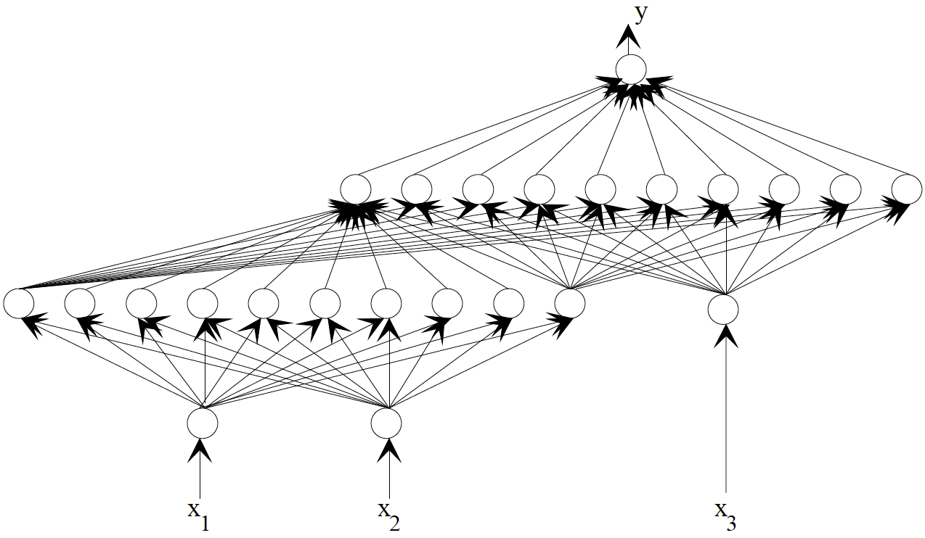
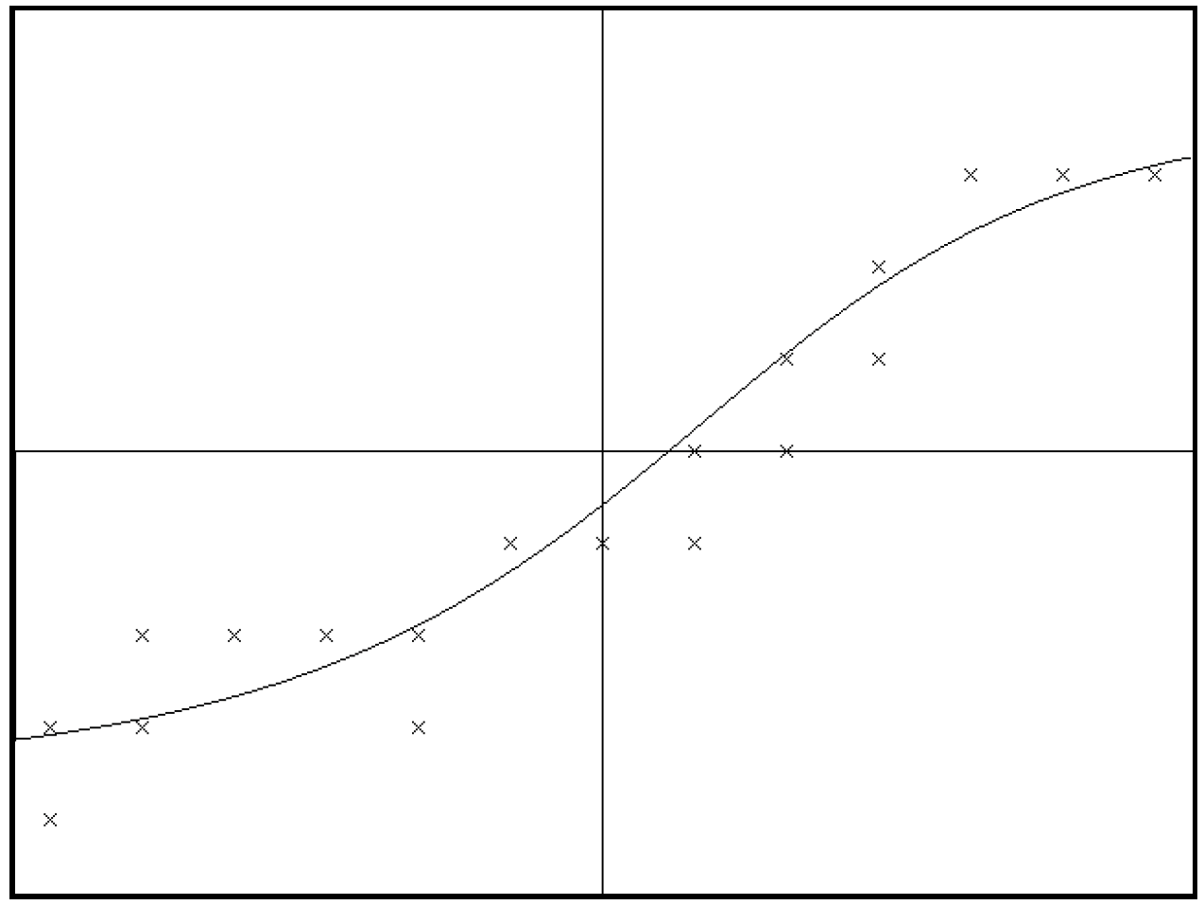
What did Kary do in 1990’s?
PhD Thesis:
  Decision support systems
  Neural networks (implemented own ones, in C++ and Matlab)
Could also be deep
Behaves nicely when interpolating but often chaotic when extrapolating even a little
(good target for adversarial attacks)

Slide 9
What did Kary do in 1990’s?
PhD Thesis:
  Decision support systems
  Neural networks (implemented own ones, in C++ and Matlab)
  Explainable AI (XAI)
Explanations can reveal errors, inconsistencies, bias, …
Contextual Importance and Utility (CIU) XAI method

Slide 10
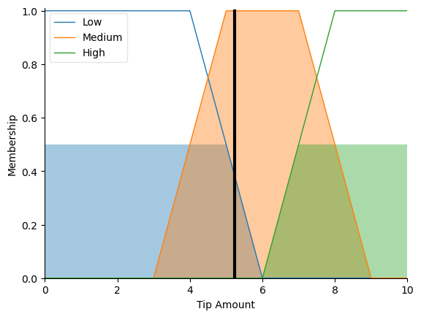
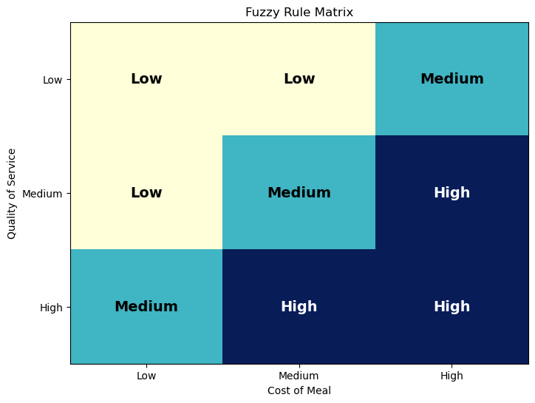
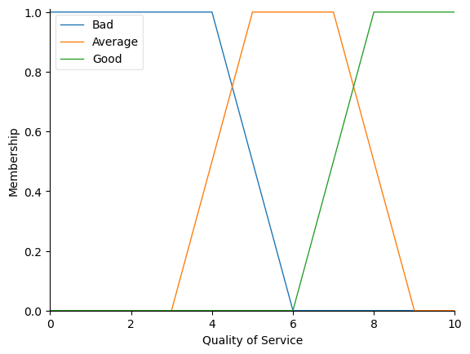
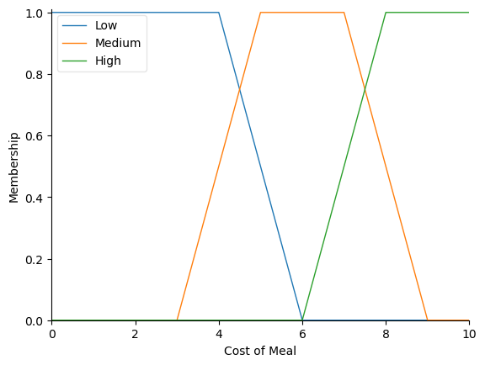
What did Kary do in 1990’s?
3 x 3 matrix is what a human expert can typically deal with
Beyond that it becomes much more challenging to validate completeness, correctness, …
PhD Thesis:
  Decision support systems
  Neural networks (implemented own ones, in C++ and Matlab)
  Explainable AI (XAI)
Some fuzzy logic
Created example controller, visualisations in less than two hours, using Mistral AI LLM
Required several iterations with error correction, improvements, …
Still, 50-95% gain in time!

Slide 11
The World from 2000 until now
AI winter more or less 2000-2014(?), then:
CNNs made a major breakthrough in 2012 when achieving outstanding recognition performance with ImageNet dataset
AlphaGo (2015-2016) is a cornerstone achievement
  Combines deep learning and reinforcement learning
Reinforcement Learning (RL) becomes big topic in academia
  But posters and papers look quite similar as they have since 1990’s…
Explainable AI (XAI) became hot after ~2017
Large Language Models (LLM) are the star of the moment

Slide 12
What did Kary do from 2000 until now?
IoT: First paper (in the world) in 2002, describing an operational implementation
  Kary was very alone with IoT until about 2010, then IoT took off seriously
  EU launched IoT program around 2006, more or less shut down a few years later
Digital Twin: Described in paper(s) since 2003 with concepts such as “virtual counterpart”, “product agent”, etc.
  Became popular at about the same time a IoT, presumably for similar reasons
  Name “Digital Twin” was first used in 2010 by NASA. By the way: do not believe what ChatGPT, Wikipedia etc. tell you about the origins, it seems to have been heavily politicized
Intelligent Products: Digital Twins (Product Agents) with an AI part that allows them to take actions
Systems of Systems since about 2008, with a big emphasis on data and communication standards
Implemented using many technologies over time and used in real-life applications, with:
  CORBA, Java RMI, SOAP, UDDI, ebXML, REST …
  Before Cloud, Edge, Fog, Python, etc. existed
Reinforcement learning 2002-2008
Back to Explainable AI (XAI) since 2018

Slide 13
Some observations of 2000 until now
New programming languages keep on taking over – Why?
REST-based: is that smart, when and why?
  Simple to implement, gives light-weight systems
What did we lose when skipping SOAP etc?
  Well-declared web service interfaces with validation and verification of types, automatic handling of intermittent connectivity, standardized lookup of services on the web, …
Machine Learning has made huge progress – but why are many ”new” researchers turning back to GOFAI? And more importantly: All the old methods and lessons seem forgotten
XAI not invented in around 2016, it’s only a new name that gained popularity
  Kary’s Contextual Importance and Utility (CIU) method from 1992 outperforms current SOTA methods such as SHAP and LIME
Seems like many academics believe that everything that is older than 5 years is obsolete, based on reviewer comments

Slide 14
What will the world do next?
LLMs – will they take over everything?
  Humanity seems to have a tendency or need to get “over-excited” about new technology
  There will be other great new things
For what are LLMs great?
  Help in programming, especially for gaining time
    Example: Implementing interoperability standards based on formal specifications
  For looking up well-known facts on which there is some consensus
  Summarizing text, generating images, …
However: LLMs give even bigger robustness challenges than ever before
  Wild extrapolation is possible, resulting in very convincing hallucinations
    Try asking “Who invented Contextual Importance and Utility method?”, for instance
  LLMs don’t seem to have any metric about the validity, certainty or robustness of their responses
  These and other challenges are not new or specific to LLMs but most people seem to be unaware of them
Conclusion: Never trust an LLM unless you have reliable means of validating the output!
Notes:
For the example: Mention what I did for TOG presentation next week, i.e. having ChatGPT

Slide 15
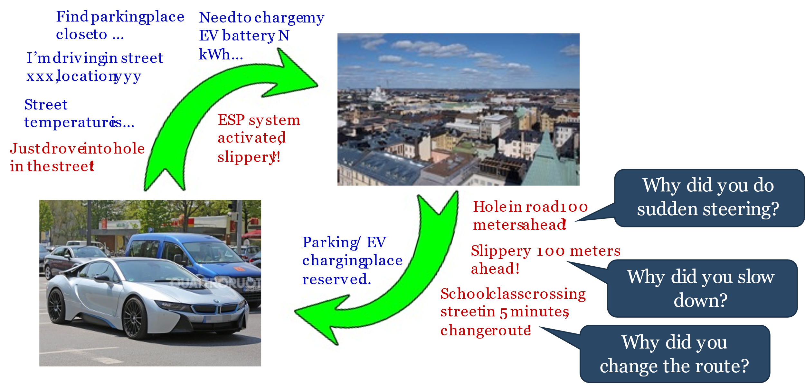
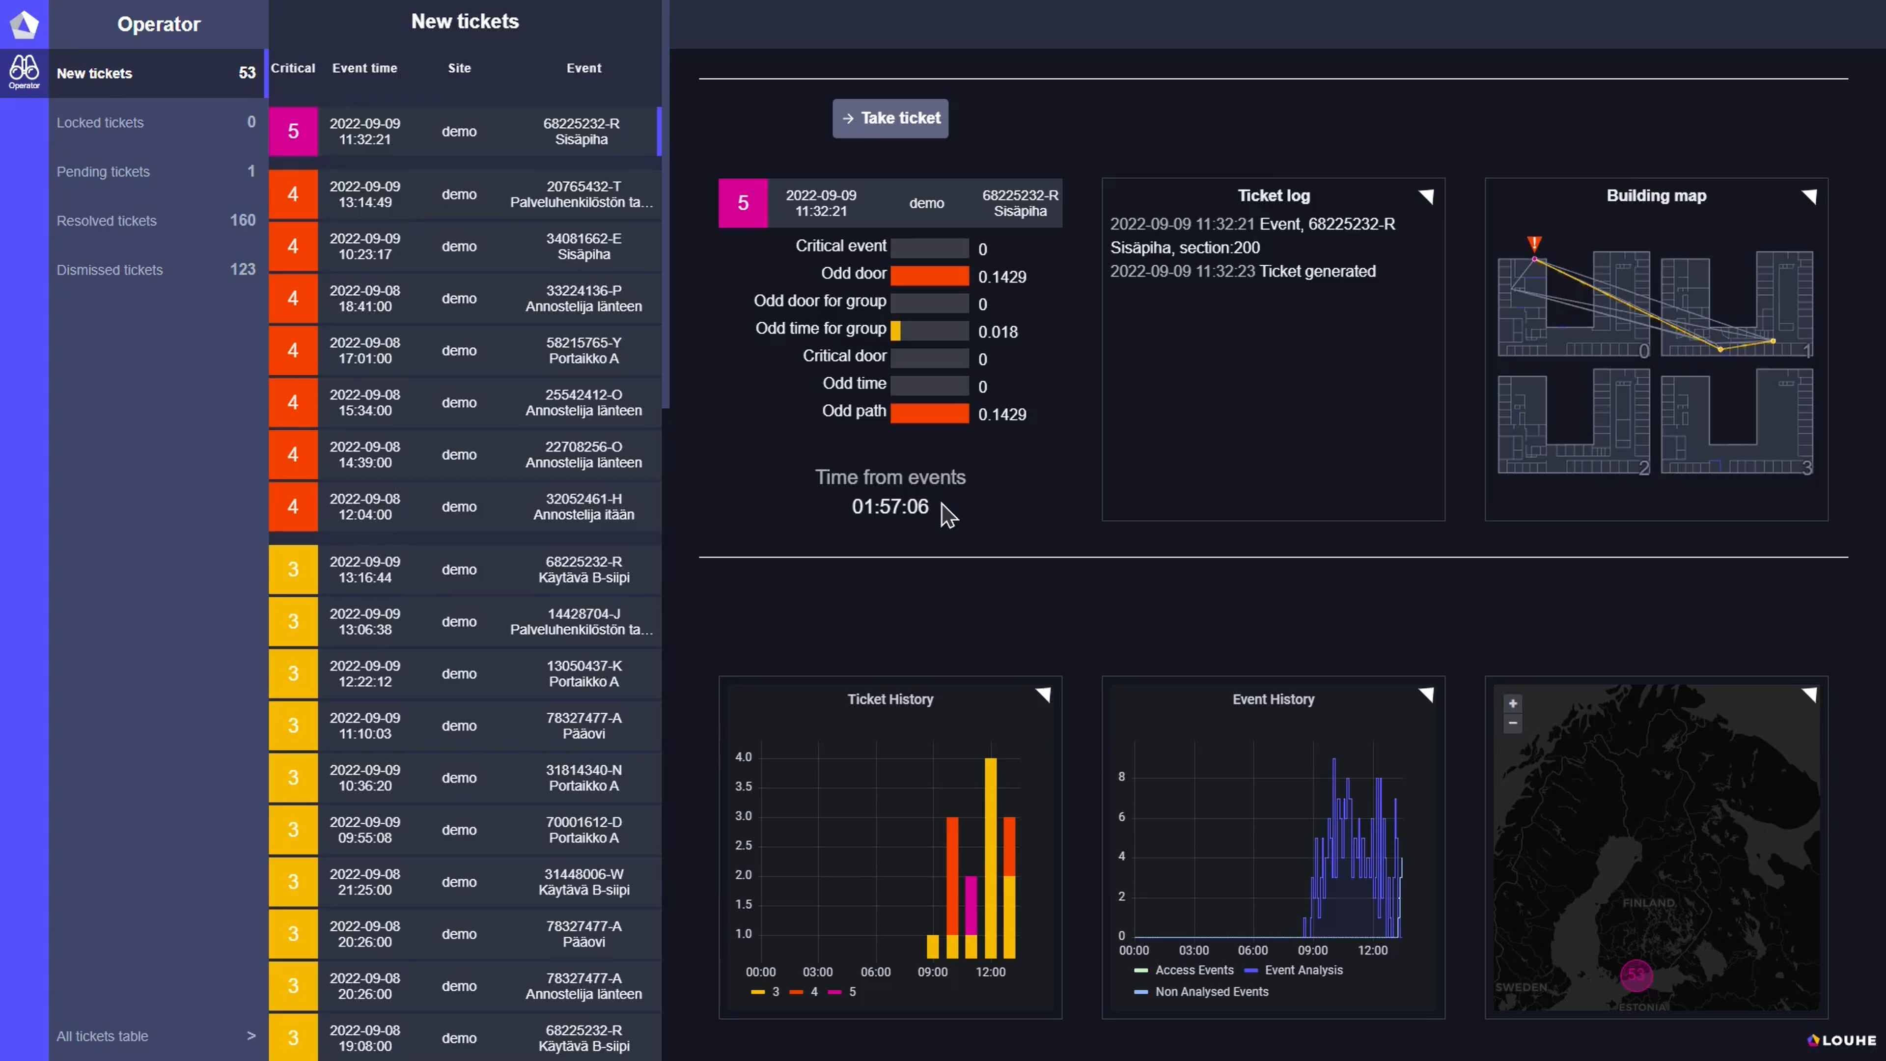
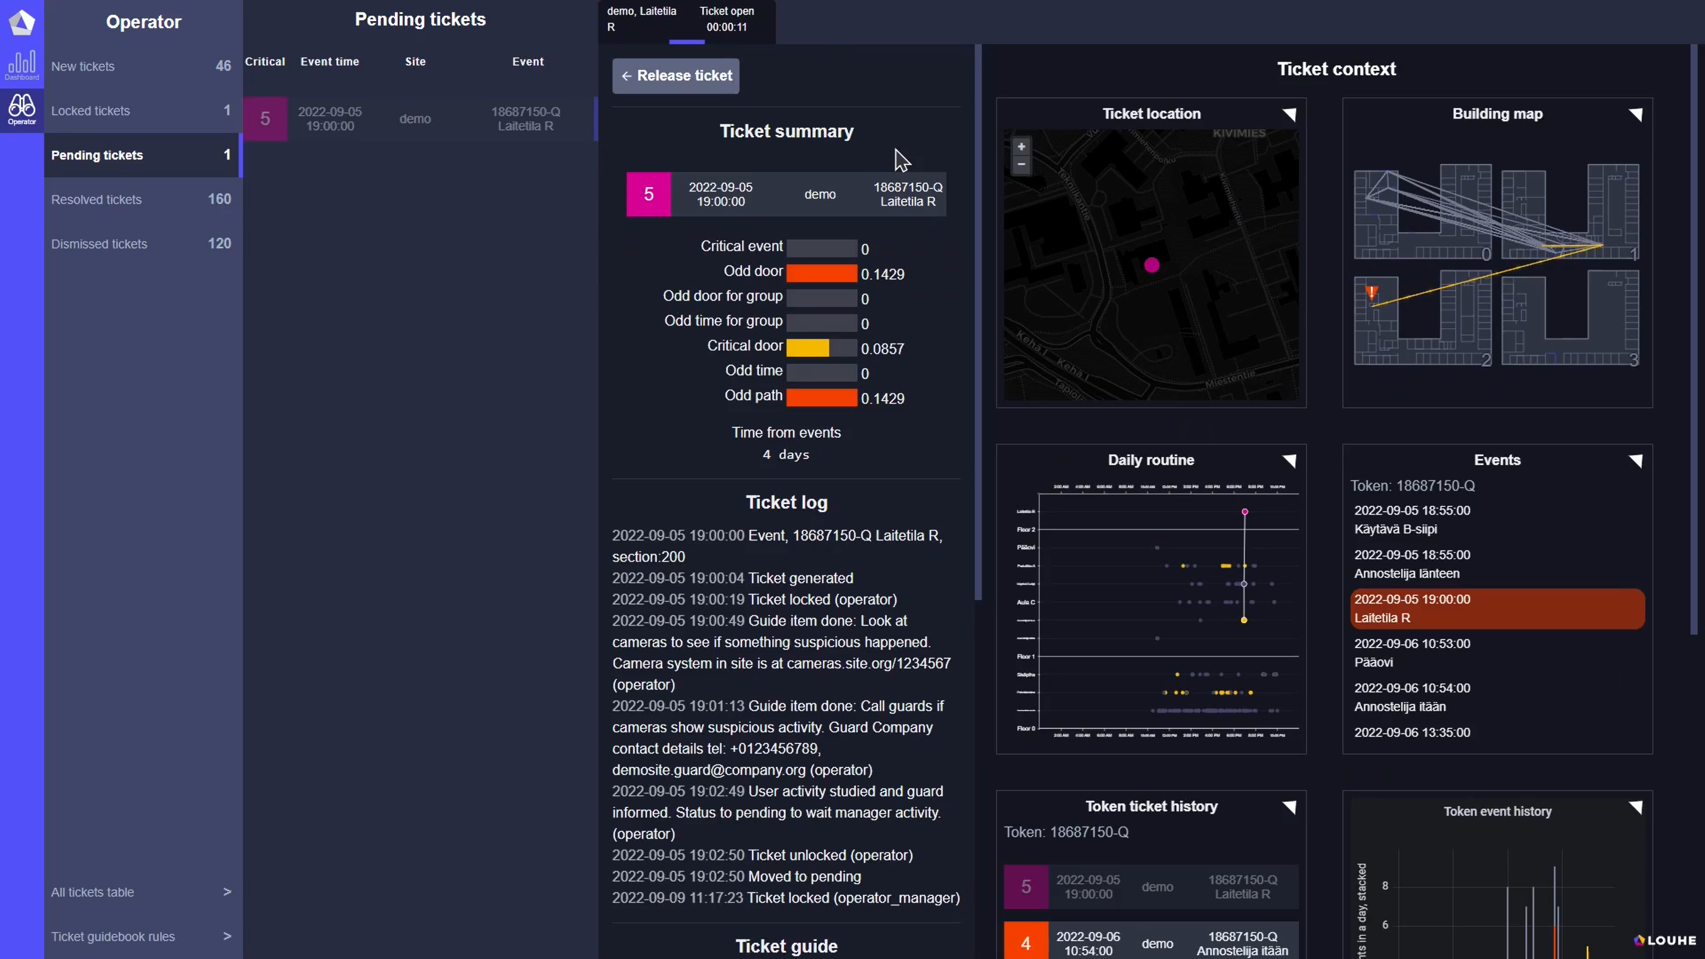
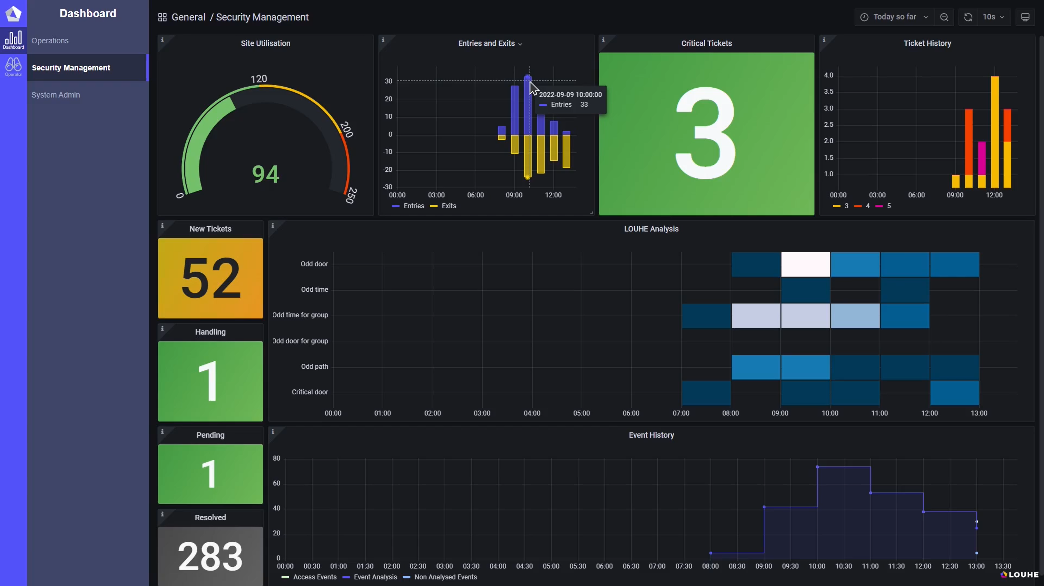

What will Kary do next
(short-term)?
Social XAI, better XAI in general
Smart X
Louhe.ai: (X)AI based cyber-physical security
Robustness, trustworthiness, explainability are more crucial than ever!
1
2
3

Slide 16
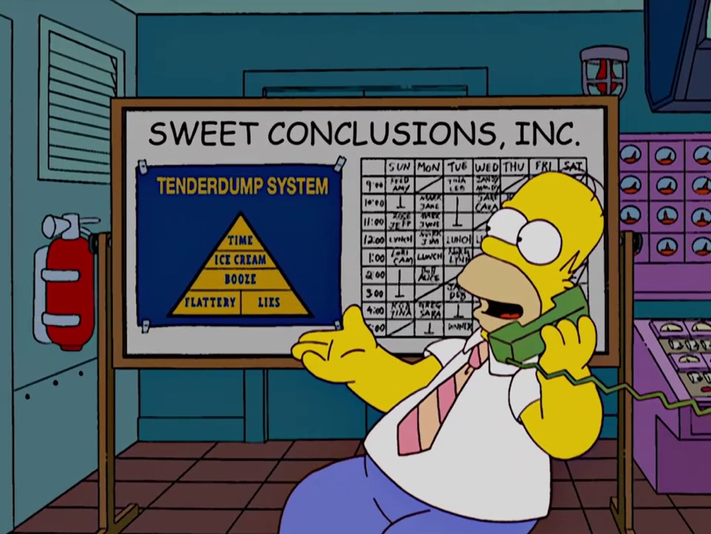
Thank you!

